Slide 1
Unit 4: Content
System Development method:
  Rational Unified Process (RUP) – Chapter 22 pp 460 – 467
Approach:
  Object modelling – Chapter 6 pp 113 – 116 & chapter 8 – pp 161 -163
Techniques
  Object orientated, UML (Unified modelling language): Class diagrammes, Use case diagrams, Interaction diagrams, Sequence diagrams, State chart diagrams, Activity diagrams, Pert charts, Gantt charts – Chapter 13 pp 273-288 & Chapter 14 pp 289-294
Dr. D de Villiers : 12th August 2014

Slide 2
Unit 5
Chapter 22

Slide 3
RUP Methodology
Object-Oriented
Methodologies

Slide 4
RUP Methodology
Rational Unified Process (RUP) is an architecture centric.
RUP is also described as iterative and incremental.

Slide 5
RUP Methodology
RUP has a number of cycles and run throughout its life cycle, viz.
  Inception
  Elaboration
  Construction; and
  Transition

Slide 6
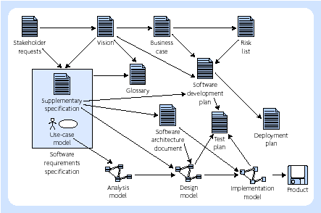
Major artifacts of RUP

Slide 7
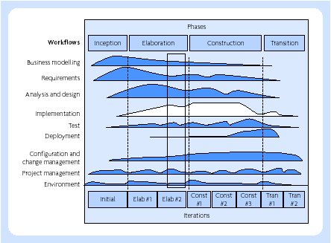
RUP Process Structure

Slide 8
Shortcomings of methods Jacobson (2000)
They are paper products, typically frozen in a book
They are rarely tried or tested in real projects (before publication)
They are simple introductions (they are insufficient for use in real, commercial development projects)
They focus on developing new systems and have little to say concerning evolving development or maintenance
They are rich in notations but lack semantics

Slide 9
Chapter 13
Object-oriented Techniques

Slide 10
Object oriented programming
Object Oriented Programming is a method of implementation in which programs are organised as a co-operative collection of objects, each of which represents an instance of some class, and whose classes are all members of a hierarchy of classes united via inheritance relationships.

Slide 11
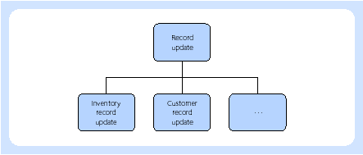
Object orientation
Hierarchy of classes

Slide 12
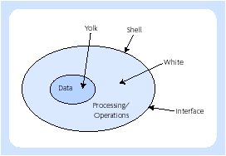
Object orientation
Objects represented by an egg
(modified from Daniels and Cook, 1992)

Slide 13
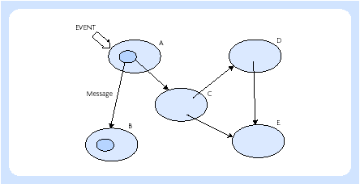
Object orientation
A network of objects make up a program

Slide 14
Chapter 14
Poject management Techniques

Slide 15
CoCoMo
1.05
PM = 2.4(KDSI)
Where PM is effort in people-months.
So, if 1,000 instructions are required, then:
PM = 2.4(1,000)
= 2.692 (or nearly three people-months)
1.05

Slide 16
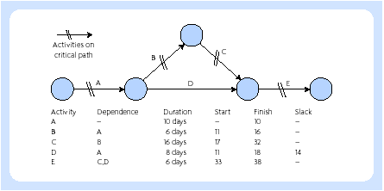
PERT charts
Project control – the network and critical path

Slide 17
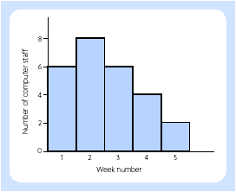
Project control
Resource schedule

Slide 18
Project control - monitoring
Compare the time schedule with the actual progress made
Compare the cost schedule with the actual costs
Maintain the involvement of users and clients
Detect problem areas
Re-plan and reschedule as a result
Provide a historical record, which can be used for future project planning

Slide 19
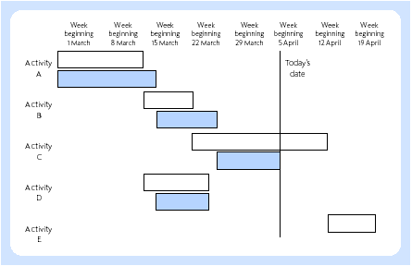
Gantt chart

